Slide 1

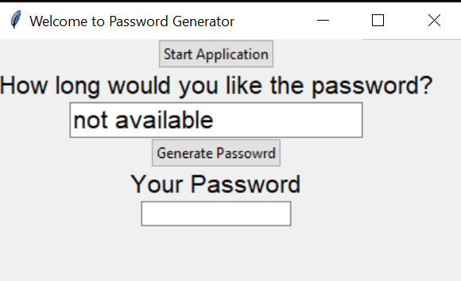
Password Generator
This is how the end product is supposed to look like. Still working on making it look like this and adding the rest of the slides to the power point.
Generate a random password in seconds to be used for various accounts.
Coders: Gates Ogork
Some references:
https://github.com/ksu-is/Password-Generator-2
https://github.com/ksu-is/PasswordListGenerator

